Slide 1
Guide to Programming with Python
Chapter Five
Lists and Dictionaries: The Hangman Game
(Modified by D. Roebuck for Delta College CST-186 Fall 2011)

Slide 2
Objectives
Create, index, and slice a list
Add and delete elements from a list
Use list methods to append, sort, and reverse a list
Use nested sequences to represent even more complex information
Use dictionaries to work with pairs of data
Add and delete dictionary items

Slide 3
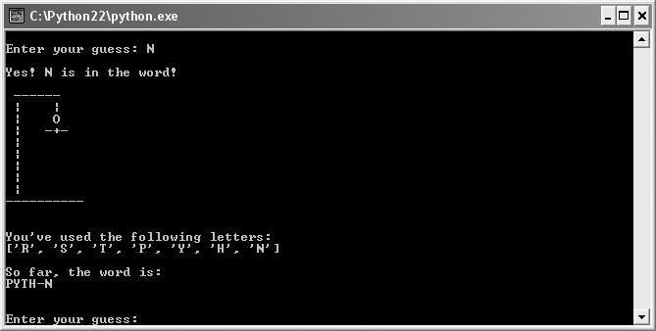
The Hangman Game
Figure 5.1: Sample run of the Hangman game
Hmm… I wonder what the word could be.

Slide 4
Using Lists
Lists
Sequences of any type
Like tuples, but mutable (can be modified)
Essentially can do everything tuples can, plus more

Slide 5
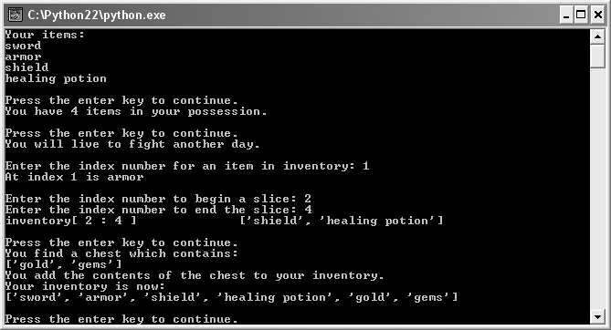
Hero’s Inventory 3.0 Program
Figure 5.4: Sample run of the Hero’s Inventory 3.0 Program
The hero’s inventory is now represented by a list.

Slide 6
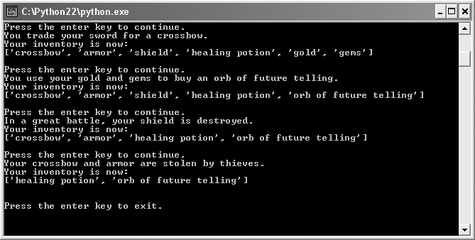
Hero’s Inventory 3.0 Program (cont.)
Figure 5.5: Sample run of Hero’s Inventory 3.0 Program (continued)
Items can be added, modified, and deleted.

Slide 7
Creating a List
List: A mutable sequence of any type
Creating an Empty List
inventory = []
Creating a List with Elements
inventory = ["sword", "armor", "shield",
"healing potion"]

Slide 8
Using len() and in with Lists
The len() function with lists
Just as with tuples, returns number of elements
print "You have", len(inventory), "items."
The in operator with lists
Just as with tuples, tests for element membership
if "healing potion" in inventory:
print "You will live to fight another day."

Slide 9
Indexing and Slicing Lists
Indexing Lists
Just as with tuples, supply the position number of the element in brackets
print "At index", index, "is", inventory[index]
Slicing Lists
Just as with tuples, supply the two end points, separated by a colon, in brackets
print inventory[begin:end]

Slide 10
Concatenating Lists
>>> inventory = ["sword", "armor", "shield",
"healing potion"]
>>> chest = ["gold", "gems"]
>>> inventory += chest
>>> print inventory
['sword', 'armor', 'shield', 'healing potion', 'gold', 'gems']
Just as with tuples, concatenation operator, +, works with lists

Slide 11
Understanding List Mutability
Mutable: Changeable
Lists are mutable
Elements (or slices) can be added
Elements (or slices) can be removed

Slide 12
Assigning a New Element by Index
>>> inventory = ["sword", "armor", "shield",
"healing potion", "gold", "gems"]
>>> inventory[0] = "crossbow"
>>> print inventory
['crossbow', 'armor', 'shield', 'healing potion', 'gold', 'gems']
Unlike with tuples, you can assign a value to an existing list element

Slide 13
Assigning a New List Slice
>>> inventory = ["crossbow", "armor", "shield",
"healing potion", "gold", "gems"]
>>> inventory[4:6] = ["orb of future telling"]
>>> print inventory
['crossbow', 'armor', 'shield', 'healing potion', 'orb of future telling']
Assignment statement replaces elements in slice with new element
Replaces the two elements inventory[4] and inventory[5] with "orb of future telling"

Slide 14
Deleting a List Element
>>> inventory = ["crossbow", "armor", "shield",
"healing potion",
"orb of future telling"]
>>> del inventory[2]
>>> print inventory
['crossbow', 'armor', 'healing potion', 'orb of future telling']
Designate element to delete after del
Deletes element at position 2

Slide 15
Deleting a List Slice
>>> inventory = ["crossbow", "armor",
"healing potion",
"orb of future telling"]
>>> del inventory[:2]
>>> print inventory
['healing potion', 'orb of future telling']
Designate slice to delete after del
Deletes slice made up of elements inventory[0] and inventory[1]

Slide 16
Using List Methods
List methods manipulate lists
Through list methods, you can:
Add an element
Remove an element
Sort a list
Reverse a list
And more

Slide 17
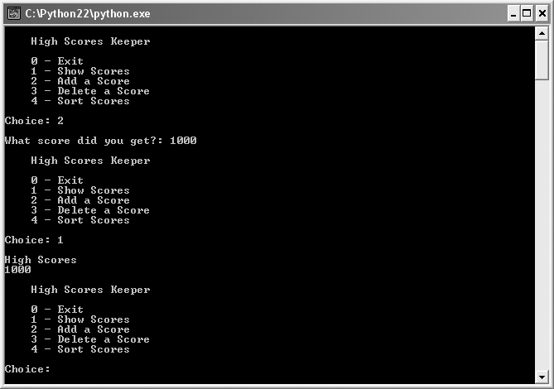
The High Scores Program
Figure 5.6: Sample run of the High Scores program
Behind the scenes, list methods do the bulk of the work.

Slide 18
The List append() Method
scores.append(score)
Adds element to the end of list
Adds score to the end of list scores

Slide 19
The List remove() Method
scores.remove(score)
Removes first occurrence of a value from a list
Attempting to remove a value, not a member, of a list will generate an error
Removes first occurrence of score from list scores

Slide 20
The List sort() Method
scores.sort()
Sorts the elements of a list (ascending order by default)

Slide 21
The List reverse() Method
scores.reverse()
Reverses the order of elements in a list

Slide 22
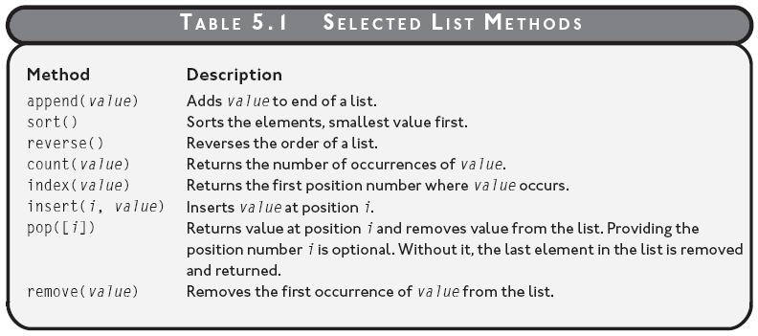
Selected List Methods
Table 5.1: Selected list methods

Slide 23
When to Use Tuples Instead of Lists
Tuples are faster than lists
Tuples’ immutability makes them perfect for creating constants because they can’t change
Sometimes tuples are required
Rule of thumb: Use lists over tuples in most cases

Slide 24
Using Nested Sequences
Nested Sequence: A sequence inside another sequence
A list can contain lists or tuples
A tuple can contain tuples or lists

Slide 25
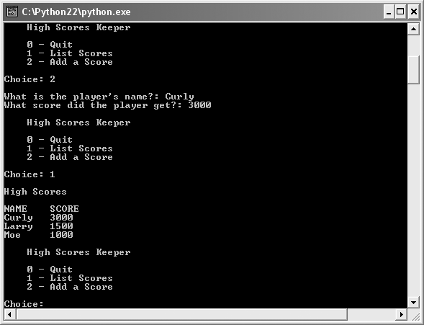
The High Scores 2.0 Program
Figure 5.7: Sample run of the High Scores 2.0 program
Improved version stores name with score through nested sequences.

Slide 26
Creating Nested Sequences
>>> scores = [("Moe", 1000), ("Larry", 1500),
("Curly", 3000)]
>>> print scores
[('Moe', 1000), ('Larry', 1500), ('Curly', 3000)]
scores is a nested sequence
scores is a list of tuples
scores has three elements, each of which is a tuple

Slide 27
Accessing Nested Elements
>>> scores = [("Moe", 1000), ("Larry", 1500),
("Curly", 3000)]
>>> print scores[2]
('Curly', 3000)
>>> print scores[2][0]
Curly
scores[2] is the element of the list at position 2
scores[2][0] is the element at position 0 of scores[2]

Slide 28
Unpacking a Sequence
>>> name, score = ("Shemp", 175)
>>> print name
Shemp
>>> print score
175
Sequence unpacking: Automatically accessing each element of a sequence
The tuple is unpacked as result of assignment statement

Slide 29
Accessing Elements of a Nested Sequence
for entry in scores:
score, name = entry
print name, "\t", score
entry is an element of scores
Assignment statement unpacks entry
score is assigned first element of entry
name is assigned second element of entry

Slide 30
Appending Elements to a Nested Sequence
entry = (score, name)
scores.append(entry)
append() method works for any list, including a list of sequences
New tuple entry is created
entry is appended to list scores as last element

Slide 31
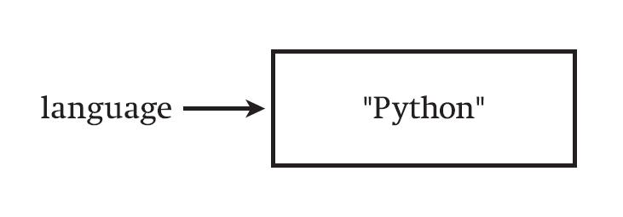
Shared References
Figure 5.8: A variable and the object it refers to
language refers to computer memory where "Python" is stored.

Slide 32
Shared References (continued)
Variables don’t store objects, they refer to objects
Shared Reference: A reference to an object, which has at least one other reference to it
Shared references have significance for mutable objects

Slide 33
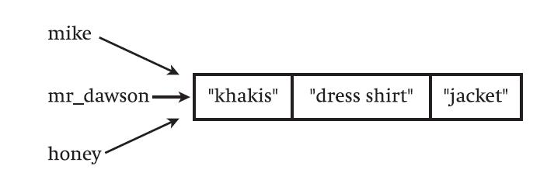
Shared References (continued)
Figure 5.9: A single object has three references to it.
Mike, mr_dawson and honey all refer to same single list.

Slide 34
Shared References (continued)
>>> mike = ["khakis", "dress shirt", "jacket"]
>>> mr_dawson = mike
>>> honey = mike
>>> print mike
['khakis', 'dress shirt', 'jacket']
>>> print mr_dawson
['khakis', 'dress shirt', 'jacket']
>>> print honey
['khakis', 'dress shirt', 'jacket']
All variables refer to same single list

Slide 35
Shared References (continued)
>>> honey[2] = "red sweater"
>>> print honey
['khakis', 'dress shirt', 'red sweater']
>>> print mike
['khakis', 'dress shirt', 'red sweater']
>>> print mr_dawson
['khakis', 'dress shirt', 'red sweater']
Change to list through one variable reflects change for all variables because there is only one list

Slide 36
Shared References (continued)
>>> mike = ["khakis", "dress shirt", "jacket"]
>>> honey = mike[:]
>>> honey[2] = "red sweater"
>>> print honey
['khakis', 'dress shirt', 'red sweater']
>>> print mike
['khakis', 'dress shirt', 'jacket']
List slicing can create a new copy of a list and avoid shared references

Slide 37
Using Dictionaries
Dictionary: A mutable collection of key-value pairs
Like tuple and list, dictionary is another built-in type
Unlike tuples and lists, dictionaries don’t organize data into sequences, but pairs
Works like actual dictionary; look up one thing to get another
Look up a key to get a value

Slide 38
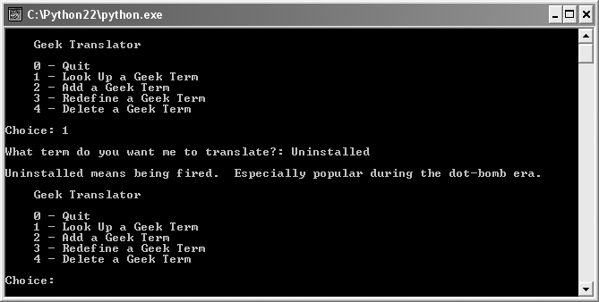
The Geek Translator Program
Figure 5.10: Sample run of the Geek Translator program
Geek terms and definitions are accessed with a dictionary.

Slide 39
Creating Dictionaries
geek = {"404" : "clueless.",
"Uninstalled" : "being fired."}
Creates new dictionary called geek
geek has two entries or items
Each item is made up of a key and a value
404 is a key of one item; use it to look up value "clueless."
Create dictionary by pairing values with colon, separated by commas, surrounded by curly braces

Slide 40
Using a Key to Retrieve a Value
>>> geek["404"]
'clueless.'
>>> geek["Uninstalled"]
'being fired.'
Use key as index to get value
Cannot use value as index to get key
Using non-existent key as index produces error
Dictionaries don't have position numbers – no order

Slide 41
Testing for a Key with the in Operator
>>> if "Dancing Baloney" in geek:
print "I know what Dancing Baloney is."
else:
print "I have no idea what Dancing Baloney is."
I have no idea what Dancing Baloney is.
Use the in operator to test for key
Condition is True if key exists in dictionary, False otherwise
in operator can't be used to test for dictionary values

Slide 42
The Dictionary get() Method
>>> geek.get("404")
'clueless.'
>>> geek.get("Dancing Baloney")
None
>>> geek.get("Dancing Baloney", "I have no idea.")
'I have no idea.'
Used for retrieving value based on key
Has built-in safety net for handling non-existent key
If key exists, returns associated value
If key doesn’t exist, returns a default value

Slide 43
Adding a Key-Value Pair
geek["Link Rot"] = "process by which web page links become obsolete."
Dictionaries are mutable
Add item by assigning value to dictionary indexed by key
Overwrites current entry if key already exists in dictionary

Slide 44
Deleting a Key-Value Pair
del geek["404"]
Removes key-value pair if key exists
Generates error if key doesn’t exist

Slide 45
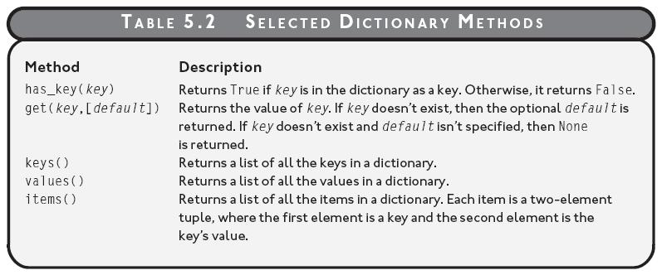
Selected Dictionary Methods
Table 5.1: Selected dictionary methods

Slide 46
Dictionary Requirements
Keys
Must be unique
Must be immutable
Values
Can be mutable or immutable
Doesn’t have to be unique

Slide 47
Summary
A list is a mutable sequence of any type
You can add or remove list elements or slices
A nested sequence is a sequence inside another sequence
Sequence unpacking is the process of automatically accessing each element of a sequence
A shared reference is a reference to an object, which has at least one other reference to it

Slide 48
Summary (continued)
A dictionary is a mutable collection of key-value pairs
In a dictionary, an item is a key-value pair
In a dictionary, a key is an object used to look up another object
In a dictionary, a value is an object that is returned when its corresponding key is looked up
The in operator can be used to test if a dictionary contains a specific key

Slide 49
Summary (continued)
A dictionary can’t contain multiple items with the same key
A dictionary can contain multiple items with the same value
Dictionary keys must be immutable
Dictionary values can be mutable

